Slide 1
To build network intrusion detection system to detect anomalies and attacks in the network.
Logistic regression problem
By Ramkumar S
Gmail id:sriramajeyam20@gmail.com

Slide 2
Business problem/objective
BUSINESS PROBLEM:
Your task to build network intrusion detection system to detect anomalies and attacks in the network. There are two problems.
1.Binomial Classification: Activity is normal or attack
2.Multinomial classification: Activity is normal or DOS or PROBE or R2L or U2R

Slide 3
Approach for the problem
Type of problem : Logistic regression
Y : y1_yes
X:service_private,last_flag,flag_REJ,dst_host_srv_count,dst_host_count,service_smtp,service_ecr_i,service_eco_i,flag_RSTO,service_urp_i,service_domain_u
Algorithms : Logistic regression
Mechanism to validate : cutoff, sensitivity, specificity, accuracy, ROC, AUC, precision, recall, decile analysis, confusion metrics

Slide 4
Data understanding
Distributions : Y variable or target variable follows normal distribution after undergoing log transformation i.e. log Y follows normal distribution.
Univariate analysis : If Y variable is dependent on a single independent variable or a feature then it is known as Univariate analysis.
Once we load data we are good to go for the first type of EDA called as univariate analysis. “Uni” means one and “Variate” means variable hence univariate analysis means analysis of one variable or one feature. Univariate basically tells us how data in each feature is distributed and also tells us about central tendencies like mean, median, and mode.
Descriptive Statistics
Continuous features First thing first, check measures of central tendencies mean, median, and mode, check min and max values and quantiles of each feature. To do all those things we just have to use pandas “describe()” function.

Slide 5
 | count | mean | std | min | 25% | 50% | 75% | max
duration | 125972.0 | 287.146929 | 2.604526e+03 | 0.0 | 0.00 | 0.00 | 0.00 | 4.290800e+04
src_bytes | 125972.0 | 45567.100824 | 5.870354e+06 | 0.0 | 0.00 | 44.00 | 276.00 | 1.379964e+09
dst_bytes | 125972.0 | 19779.271433 | 4.021285e+06 | 0.0 | 0.00 | 0.00 | 516.00 | 1.309937e+09
land | 125972.0 | 0.000198 | 1.408613e-02 | 0.0 | 0.00 | 0.00 | 0.00 | 1.000000e+00
wrong_fragment | 125972.0 | 0.022688 | 2.535310e-01 | 0.0 | 0.00 | 0.00 | 0.00 | 3.000000e+00
urgent | 125972.0 | 0.000111 | 1.436608e-02 | 0.0 | 0.00 | 0.00 | 0.00 | 3.000000e+00
hot | 125972.0 | 0.204411 | 2.149977e+00 | 0.0 | 0.00 | 0.00 | 0.00 | 7.700000e+01
num_failed_logins | 125972.0 | 0.001222 | 4.523932e-02 | 0.0 | 0.00 | 0.00 | 0.00 | 5.000000e+00
logged_in | 125972.0 | 0.395739 | 4.890107e-01 | 0.0 | 0.00 | 0.00 | 1.00 | 1.000000e+00
num_compromised | 125972.0 | 0.279253 | 2.394214e+01 | 0.0 | 0.00 | 0.00 | 0.00 | 7.479000e+03
root_shell | 125972.0 | 0.001342 | 3.660299e-02 | 0.0 | 0.00 | 0.00 | 0.00 | 1.000000e+00
su_attempted | 125972.0 | 0.001103 | 4.515456e-02 | 0.0 | 0.00 | 0.00 | 0.00 | 2.000000e+00
num_root | 125972.0 | 0.302194 | 2.439971e+01 | 0.0 | 0.00 | 0.00 | 0.00 | 7.468000e+03
num_file_creations | 125972.0 | 0.012669 | 4.839370e-01 | 0.0 | 0.00 | 0.00 | 0.00 | 4.300000e+01
num_shells | 125972.0 | 0.000413 | 2.218122e-02 | 0.0 | 0.00 | 0.00 | 0.00 | 2.000000e+00
num_access_files | 125972.0 | 0.004096 | 9.936995e-02 | 0.0 | 0.00 | 0.00 | 0.00 | 9.000000e+00
num_outbound_cmds | 125972.0 | 0.000000 | 0.000000e+00 | 0.0 | 0.00 | 0.00 | 0.00 | 0.000000e+00
is_host_login | 125972.0 | 0.000008 | 2.817494e-03 | 0.0 | 0.00 | 0.00 | 0.00 | 1.000000e+00
is_guest_login | 125972.0 | 0.009423 | 9.661271e-02 | 0.0 | 0.00 | 0.00 | 0.00 | 1.000000e+00
count | 125972.0 | 84.108207 | 1.145088e+02 | 0.0 | 2.00 | 14.00 | 143.00 | 5.110000e+02
srv_count | 125972.0 | 27.738093 | 7.263609e+01 | 0.0 | 2.00 | 8.00 | 18.00 | 5.110000e+02
serror_rate | 125972.0 | 0.284487 | 4.464567e-01 | 0.0 | 0.00 | 0.00 | 1.00 | 1.000000e+00
srv_serror_rate | 125972.0 | 0.282488 | 4.470236e-01 | 0.0 | 0.00 | 0.00 | 1.00 | 1.000000e+00
rerror_rate | 125972.0 | 0.119959 | 3.204366e-01 | 0.0 | 0.00 | 0.00 | 0.00 | 1.000000e+00
srv_rerror_rate | 125972.0 | 0.121184 | 3.236483e-01 | 0.0 | 0.00 | 0.00 | 0.00 | 1.000000e+00
same_srv_rate | 125972.0 | 0.660925 | 4.396236e-01 | 0.0 | 0.09 | 1.00 | 1.00 | 1.000000e+00
diff_srv_rate | 125972.0 | 0.063053 | 1.803150e-01 | 0.0 | 0.00 | 0.00 | 0.06 | 1.000000e+00
srv_diff_host_rate | 125972.0 | 0.097322 | 2.598314e-01 | 0.0 | 0.00 | 0.00 | 0.00 | 1.000000e+00
dst_host_count | 125972.0 | 182.149200 | 9.920657e+01 | 0.0 | 82.00 | 255.00 | 255.00 | 2.550000e+02
dst_host_srv_count | 125972.0 | 115.653725 | 1.107029e+02 | 0.0 | 10.00 | 63.00 | 255.00 | 2.550000e+02
dst_host_same_srv_rate | 125972.0 | 0.521244 | 4.489501e-01 | 0.0 | 0.05 | 0.51 | 1.00 | 1.000000e+00
dst_host_diff_srv_rate | 125972.0 | 0.082952 | 1.889225e-01 | 0.0 | 0.00 | 0.02 | 0.07 | 1.000000e+00
dst_host_same_src_port_rate | 125972.0 | 0.148379 | 3.089984e-01 | 0.0 | 0.00 | 0.00 | 0.06 | 1.000000e+00
dst_host_srv_diff_host_rate | 125972.0 | 0.032543 | 1.125642e-01 | 0.0 | 0.00 | 0.00 | 0.02 | 1.000000e+00
dst_host_serror_rate | 125972.0 | 0.284455 | 4.447851e-01 | 0.0 | 0.00 | 0.00 | 1.00 | 1.000000e+00
dst_host_srv_serror_rate | 125972.0 | 0.278487 | 4.456702e-01 | 0.0 | 0.00 | 0.00 | 1.00 | 1.000000e+00
dst_host_rerror_rate | 125972.0 | 0.118832 | 3.065586e-01 | 0.0 | 0.00 | 0.00 | 0.00 | 1.000000e+00
dst_host_srv_rerror_rate | 125972.0 | 0.120241 | 3.194605e-01 | 0.0 | 0.00 | 0.00 | 0.00 | 1.000000e+00
last_flag | 125972.0 | 19.504056 | 2.291512e+00 | 0.0 | 18.00 | 20.00 | 21.00 | 2.100000e+01

Slide 6
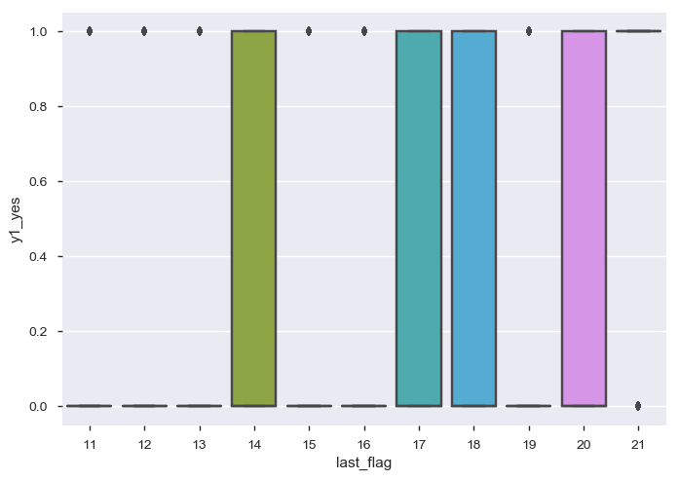
Bivariate analysis
Bivariate analysis:- is performed to find the relationship between each variable in the dataset and the target variable of interest (or) using 2 variables and finding relationship between them. Ex:-Box plot, Voilin plot.
Bivariate analysis
box plot
sns.boxplot(x = "last_flag",y = "y1_yes",data = t5_new)
plt.show()

Slide 7
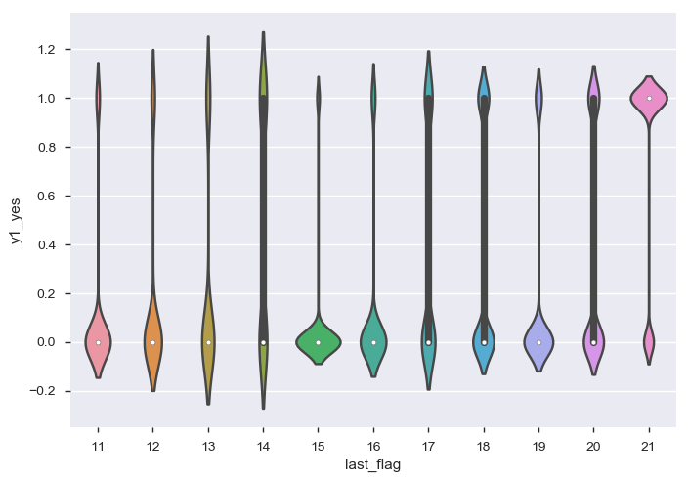
Bivariate analysis
violinplot
sns.violinplot(x = "last_flag",y = "y1_yes",data = t5_new)
plt.show()

Slide 8
Data understanding
Variable types
Numeric | 26
Categorical | 5
Boolean | 5
Date | 0
Text (Unique) | 0
Rejected | 8
Unsupported | 0

Slide 9
Assumptions based on the data understanding
1.Y variable should follow normal distribution.
2.Multicollinearity should not be present in the dataset.
3.Missing values should not be above 25%.
4.Variables with low variance should not be present in the dataset.
5.Outliers should not be present in the dataset.

Slide 10
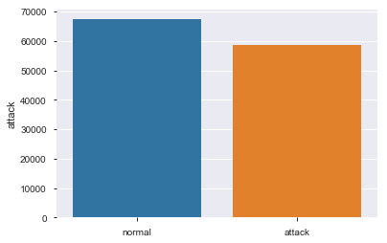
Data exploratory analysis
Provide detail insights :

Slide 11
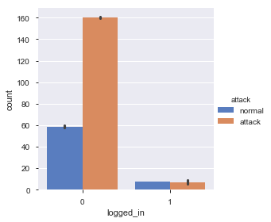
Data exploratory analysis

Slide 12
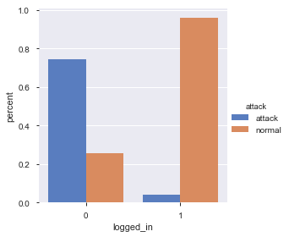
Data exploratory analysis

Slide 13
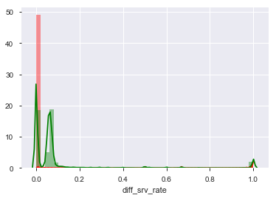
Data exploratory analysis

Slide 14
Detailed Data audit report with all the possible outputs
 | duration | src_bytes | dst_bytes | land | wrong_fragment | urgent | hot | num_failed_logins | logged_in | num_compromised | ... | dst_host_srv_count | dst_host_same_srv_rate | dst_host_diff_srv_rate | dst_host_same_src_port_rate | dst_host_srv_diff_host_rate | dst_host_serror_rate | dst_host_srv_serror_rate | dst_host_rerror_rate | dst_host_srv_rerror_rate | Last_flag
N | 1.259720e+05 | 1.259720e+05 | 1.259720e+05 | 125972.000000 | 125972.000000 | 125972.000000 | 125972.000000 | 125972.000000 | 125972.000000 | 125972.000000 | ... | 1.259720e+05 | 125972.000000 | 125972.000000 | 125972.000000 | 125972.000000 | 125972.000000 | 125972.000000 | 125972.000000 | 125972.000000 | 1.259720e+05
NMISS | 0.000000e+00 | 0.000000e+00 | 0.000000e+00 | 0.000000 | 0.000000 | 0.000000 | 0.000000 | 0.000000 | 0.000000 | 0.000000 | ... | 0.000000e+00 | 0.000000 | 0.000000 | 0.000000 | 0.000000 | 0.000000 | 0.000000 | 0.000000 | 0.000000 | 0.000000e+00
SUM | 3.617247e+07 | 5.740179e+09 | 2.491634e+09 | 25.000000 | 2858.000000 | 14.000000 | 25750.000000 | 154.000000 | 49852.000000 | 35178.000000 | ... | 1.456913e+07 | 65662.210000 | 10449.570000 | 18691.560000 | 4099.470000 | 35833.330000 | 35081.530000 | 14969.550000 | 15146.980000 | 2.456965e+06
MEAN | 2.871469e+02 | 4.556710e+04 | 1.977927e+04 | 0.000198 | 0.022688 | 0.000111 | 0.204411 | 0.001222 | 0.395739 | 0.279253 | ... | 1.156537e+02 | 0.521244 | 0.082952 | 0.148379 | 0.032543 | 0.284455 | 0.278487 | 0.118832 | 0.120241 | 1.950406e+01
MEDIAN | 0.000000e+00 | 4.400000e+01 | 0.000000e+00 | 0.000000 | 0.000000 | 0.000000 | 0.000000 | 0.000000 | 0.000000 | 0.000000 | ... | 6.300000e+01 | 0.510000 | 0.020000 | 0.000000 | 0.000000 | 0.000000 | 0.000000 | 0.000000 | 0.000000 | 2.000000e+01
STD | 2.604526e+03 | 5.870354e+06 | 4.021285e+06 | 0.014086 | 0.253531 | 0.014366 | 2.149977 | 0.045239 | 0.489011 | 23.942137 | ... | 1.107029e+02 | 0.448950 | 0.188922 | 0.308998 | 0.112564 | 0.444785 | 0.445670 | 0.306559 | 0.319460 | 2.291512e+00
VAR | 6.783553e+06 | 3.446106e+13 | 1.617073e+13 | 0.000198 | 0.064278 | 0.000206 | 4.622401 | 0.002047 | 0.239131 | 573.225937 | ... | 1.225513e+04 | 0.201556 | 0.035692 | 0.095480 | 0.012671 | 0.197834 | 0.198622 | 0.093978 | 0.102055 | 5.251025e+00
MIN | 0.000000e+00 | 0.000000e+00 | 0.000000e+00 | 0.000000 | 0.000000 | 0.000000 | 0.000000 | 0.000000 | 0.000000 | 0.000000 | ... | 0.000000e+00 | 0.000000 | 0.000000 | 0.000000 | 0.000000 | 0.000000 | 0.000000 | 0.000000 | 0.000000 | 0.000000e+00
P1 | 0.000000e+00 | 0.000000e+00 | 0.000000e+00 | 0.000000 | 0.000000 | 0.000000 | 0.000000 | 0.000000 | 0.000000 | 0.000000 | ... | 1.000000e+00 | 0.000000 | 0.000000 | 0.000000 | 0.000000 | 0.000000 | 0.000000 | 0.000000 | 0.000000 | 1.100000e+01
P5 | 0.000000e+00 | 0.000000e+00 | 0.000000e+00 | 0.000000 | 0.000000 | 0.000000 | 0.000000 | 0.000000 | 0.000000 | 0.000000 | ... | 1.000000e+00 | 0.000000 | 0.000000 | 0.000000 | 0.000000 | 0.000000 | 0.000000 | 0.000000 | 0.000000 | 1.500000e+01
P10 | 0.000000e+00 | 0.000000e+00 | 0.000000e+00 | 0.000000 | 0.000000 | 0.000000 | 0.000000 | 0.000000 | 0.000000 | 0.000000 | ... | 2.000000e+00 | 0.010000 | 0.000000 | 0.000000 | 0.000000 | 0.000000 | 0.000000 | 0.000000 | 0.000000 | 1.700000e+01
P25 | 0.000000e+00 | 0.000000e+00 | 0.000000e+00 | 0.000000 | 0.000000 | 0.000000 | 0.000000 | 0.000000 | 0.000000 | 0.000000 | ... | 1.000000e+01 | 0.050000 | 0.000000 | 0.000000 | 0.000000 | 0.000000 | 0.000000 | 0.000000 | 0.000000 | 1.800000e+01
P50 | 0.000000e+00 | 4.400000e+01 | 0.000000e+00 | 0.000000 | 0.000000 | 0.000000 | 0.000000 | 0.000000 | 0.000000 | 0.000000 | ... | 6.300000e+01 | 0.510000 | 0.020000 | 0.000000 | 0.000000 | 0.000000 | 0.000000 | 0.000000 | 0.000000 | 2.000000e+01
P75 | 0.000000e+00 | 2.760000e+02 | 5.160000e+02 | 0.000000 | 0.000000 | 0.000000 | 0.000000 | 0.000000 | 1.000000 | 0.000000 | ... | 2.550000e+02 | 1.000000 | 0.070000 | 0.060000 | 0.020000 | 1.000000 | 1.000000 | 0.000000 | 0.000000 | 2.100000e+01
P90 | 0.000000e+00 | 8.480000e+02 | 3.375900e+03 | 0.000000 | 0.000000 | 0.000000 | 0.000000 | 0.000000 | 1.000000 | 0.000000 | ... | 2.550000e+02 | 1.000000 | 0.100000 | 0.840000 | 0.050000 | 1.000000 | 1.000000 | 0.840000 | 1.000000 | 2.100000e+01
P95 | 4.000000e+00 | 1.480000e+03 | 8.314000e+03 | 0.000000 | 0.000000 | 0.000000 | 0.000000 | 0.000000 | 1.000000 | 0.000000 | ... | 2.550000e+02 | 1.000000 | 0.560000 | 1.000000 | 0.180000 | 1.000000 | 1.000000 | 1.000000 | 1.000000 | 2.100000e+01
P99 | 9.590580e+03 | 5.454000e+04 | 2.551900e+04 | 0.000000 | 0.000000 | 0.000000 | 3.000000 | 0.000000 | 1.000000 | 1.000000 | ... | 2.550000e+02 | 1.000000 | 1.000000 | 1.000000 | 0.520000 | 1.000000 | 1.000000 | 1.000000 | 1.000000 | 2.100000e+01
MAX | 4.290800e+04 | 1.379964e+09 | 1.309937e+09 | 1.000000 | 3.000000 | 3.000000 | 77.000000 | 5.000000 | 1.000000 | 7479.000000 | ... | 2.550000e+02 | 1.000000 | 1.000000 | 1.000000 | 1.000000 | 1.000000 | 1.000000 | 1.000000 | 1.000000 | 2.100000e+01

Slide 15
Detailed data preparations
Missing value treatment
#Handling missings
def Missing_imputation(x):
x = x.fillna(x.median())
return x
t4_num=t4_num.apply(lambda x: Missing_imputation(x))
Outlier treatment
#Handling Outliers
def outlier_capping(x):
x = x.clip_upper(x.quantile(0.99))
x = x.clip_lower(x.quantile(0.01))
return x
t4_num=t4_num.apply(lambda x: outlier_capping(x))

Slide 16
Missing value treatment & outlier treatment
 | 0 | 1 | 2 | 3 | 4
duration | 0.00 | 0.00 | 0.00 | 0.00 | 0.00
src_bytes | 146.00 | 0.00 | 232.00 | 199.00 | 0.00
dst_bytes | 0.00 | 0.00 | 8153.00 | 420.00 | 0.00
land | 0.00 | 0.00 | 0.00 | 0.00 | 0.00
wrong_fragment | 0.00 | 0.00 | 0.00 | 0.00 | 0.00
urgent | 0.00 | 0.00 | 0.00 | 0.00 | 0.00
hot | 0.00 | 0.00 | 0.00 | 0.00 | 0.00
num_failed_logins | 0.00 | 0.00 | 0.00 | 0.00 | 0.00
logged_in | 0.00 | 0.00 | 1.00 | 1.00 | 0.00
num_compromised | 0.00 | 0.00 | 0.00 | 0.00 | 0.00
root_shell | 0.00 | 0.00 | 0.00 | 0.00 | 0.00
su_attempted | 0.00 | 0.00 | 0.00 | 0.00 | 0.00
num_root | 0.00 | 0.00 | 0.00 | 0.00 | 0.00
num_file_creations | 0.00 | 0.00 | 0.00 | 0.00 | 0.00
num_shells | 0.00 | 0.00 | 0.00 | 0.00 | 0.00
num_access_files | 0.00 | 0.00 | 0.00 | 0.00 | 0.00
num_outbound_cmds | 0.00 | 0.00 | 0.00 | 0.00 | 0.00
is_host_login | 0.00 | 0.00 | 0.00 | 0.00 | 0.00
is_guest_login | 0.00 | 0.00 | 0.00 | 0.00 | 0.00
count | 13.00 | 123.00 | 5.00 | 30.00 | 121.00
srv_count | 1.00 | 6.00 | 5.00 | 32.00 | 19.00
serror_rate | 0.00 | 1.00 | 0.20 | 0.00 | 0.00
srv_serror_rate | 0.00 | 1.00 | 0.20 | 0.00 | 0.00
rerror_rate | 0.00 | 0.00 | 0.00 | 0.00 | 1.00
srv_rerror_rate | 0.00 | 0.00 | 0.00 | 0.00 | 1.00
same_srv_rate | 0.08 | 0.05 | 1.00 | 1.00 | 0.16
diff_srv_rate | 0.15 | 0.07 | 0.00 | 0.00 | 0.06
srv_diff_host_rate | 0.00 | 0.00 | 0.00 | 0.09 | 0.00
dst_host_count | 255.00 | 255.00 | 30.00 | 255.00 | 255.00
dst_host_srv_count | 1.00 | 26.00 | 255.00 | 255.00 | 19.00
dst_host_same_srv_rate | 0.00 | 0.10 | 1.00 | 1.00 | 0.07
dst_host_diff_srv_rate | 0.60 | 0.05 | 0.00 | 0.00 | 0.07
dst_host_same_src_port_rate | 0.88 | 0.00 | 0.03 | 0.00 | 0.00
dst_host_srv_diff_host_rate | 0.00 | 0.00 | 0.04 | 0.00 | 0.00
dst_host_serror_rate | 0.00 | 1.00 | 0.03 | 0.00 | 0.00
dst_host_srv_serror_rate | 0.00 | 1.00 | 0.01 | 0.00 | 0.00
dst_host_rerror_rate | 0.00 | 0.00 | 0.00 | 0.00 | 1.00
dst_host_srv_rerror_rate | 0.00 | 0.00 | 0.01 | 0.00 | 1.00
last_flag | 15.00 | 19.00 | 21.00 | 21.00 | 21.00

Slide 17
Dummies creations
# An utility function to create dummy variable
def create_dummies( df, colname ):
col_dummies = pd.get_dummies(df[colname], prefix=colname, drop_first=True)
#col_dummies.drop(col_dummies.columns[0], axis=1, inplace=True)
df = pd.concat([df, col_dummies], axis=1)
df.drop( colname, axis = 1, inplace = True )
return df
# for c_feature in categorical_features
t4_cat_new = t4_cat
for c_feature in cat_var_names:
t4_cat_new[c_feature] = t4_cat_new[c_feature].astype('category')
t4_cat_new = create_dummies(t4_cat_new , c_feature )

Slide 18
Multi collinearity
 | VIF factor | Features
0 | 125.976387 | Intercept
1 | 1.303091 | service_private
2 | 1.389484 | last_flag
3 | 1.073933 | flag_REJ
4 | 1.620618 | dst_host_srv_count
5 | 1.377659 | dst_host_count
6 | 1.033748 | service_uucp
7 | 1.056829 | service_smtp
8 | 1.055164 | service_ecr_i
9 | 1.278882 | service_eco_i
10 | 1.120827 | flag_RSTR
11 | 1.002523 | flag_RSTOS0
12 | 1.040338 | flag_RSTO
13 | 1.011356 | service_urp_i
14 | 1.01046 | service_gopher
15 | 1.175184 | service_domain_u
16 | 1.012218 | flag_SH

Slide 19
Multi collinearity
dst_host_rerror_rate is highly correlated with srv_rerror_rate (ρ = 0.91782) Rejected
dst_host_serror_rate is highly correlated with srv_serror_rate (ρ = 0.9776) Rejected
dst_host_srv_rerror_rate is highly correlated with dst_host_rerror_rate (ρ = 0.92469) Rejected
dst_host_srv_serror_rate is highly correlated with dst_host_serror_rate (ρ = 0.98505) Rejected
num_outbound_cmds has constant value 0 Rejected
num_root is highly correlated with num_compromised (ρ = 0.99883) Rejected
srv_rerror_rate is highly correlated with rerror_rate (ρ = 0.98901) Rejected
srv_serror_rate is highly correlated with serror_rate (ρ = 0.99329) Rejected

Slide 20
Feature Engineering
Feature Engineering |  | new variable creation=Dummy variables created using categorical variables is 83
Variable reduction (Regression problem)
Variable reduction | Numerical variables=39,Dummy variables using categorical variables=83. Total=122 variables | Numerical variables=39,Dummy variables using categorical variables=83. Total=122 variables | 21 variables dropped because of high zeros i.e above 25%. 7 variables dropped because of high correlation with other variables. 1 variable dropped because of having constant value 0
 |  |  | 5 variables are selected using WOE 12 variables are selected using SomersD 15 variables are selected using RFE 15 variables are selected using Kbest method
 |  |  | 17 variables are selected using VIF assessment
 | 11 variables | 11 variables | 11 variables are selected using P-value of estimates

Slide 21
Model pre-requisites/Model assumptions
Model pre-requisites :
First, logistic regression does not require a linear relationship between the dependent and independent variables. Second, the error terms (residuals) do not need to be normally distributed. Third, homoscedasticity is not required. Finally, the dependent variable in logistic regression is not measured on an interval or ratio scale.
However, some other assumptions still apply.
First, binary logistic regression requires the dependent variable to be binary and ordinal logistic regression requires the dependent variable to be ordinal.
Second, logistic regression requires the observations to be independent of each other. In other words, the observations should not come from repeated measurements or matched data.
Third, logistic regression requires there to be little or no multicollinearity among the independent variables. This means that the independent variables should not be too highly correlated with each other.
Fourth, logistic regression assumes linearity of independent variables and log odds. although this analysis does not require the dependent and independent variables to be related linearly, it requires that the independent variables are linearly related to the log odds.
Finally, logistic regression typically requires a large sample size. A general guideline is that you need at minimum of 10 cases with the least frequent outcome for each independent variable in your model.

Slide 22
Define train & test
The reasons for splitting
The training dataset (also called training set, learning set, or AI training data) is the initial dataset used to train an algorithm to understand how to apply technologies such as neural networks, to learn and produce complex results. It includes both input data and the corresponding expected output. The purpose of the training dataset is to provide your algorithm with “ground truth” data.
The test dataset, however, is used to assess how well your algorithm was trained with the training dataset. You can’t simply reuse the training dataset in the testing stage because the algorithm will already “know” the expected output, which defeats the purpose of testing the algorithm.
Make sure that your test set meets the following two conditions:
Is large enough to yield statistically meaningful results.
Is representative of the data set as a whole. In other words, don't pick a test set with different characteristics than the training set.
Assuming that your test set meets the preceding two conditions, your goal is to create a model that generalizes well to new data. Our test set serves as a proxy for new data.
The algorithm will try to minimize the error within the training set. When training is done, the algorithm has seen all the data in training set. However, we want to know if the algorithm can be used for further forecasting, we want to know how the algorithm works when given the unseen data.

Slide 23
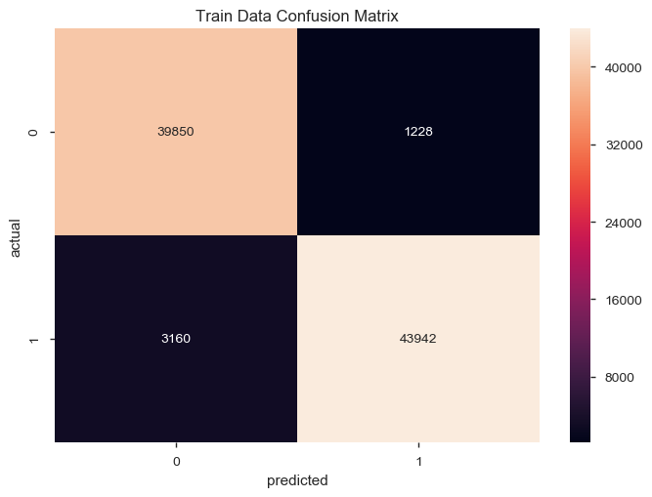
Y variable distribution

Slide 24

Y variable distribution

Slide 25
Observations distribution
Train is having 70% observations and Test is having 30% observations. Thus Observations are distributed.

Slide 26
Detailed model output
Model outputs from the tool (compare multiple iterations)
Results: Logit
===================================================================
Model: Logit Pseudo R-squared: 0.757
Dependent Variable: y1_yes AIC: 29682.0239
Date: 2019-08-03 17:14 BIC: 29794.6696
No. Observations: 88180 Log-Likelihood: -14829.
Df Model: 11 LL-Null: -60916.
Df Residuals: 88168 LLR p-value: 0.0000
Converged: 1.0000 Scale: 1.0000
No. Iterations: 11.0000
-------------------------------------------------------------------
Coef. Std.Err. z P>|z| [0.025 0.975]
-------------------------------------------------------------------
Intercept -8.8604 0.1532 -57.8217 0.0000 -9.1607 -8.5601
service_private -2.8075 0.0526 -53.4048 0.0000 -2.9105 -2.7044
last_flag 0.5978 0.0087 68.5585 0.0000 0.5807 0.6149
flag_REJ -1.8492 0.0843 -21.9435 0.0000 -2.0144 -1.6840
dst_host_srv_count 0.0221 0.0003 87.7768 0.0000 0.0216 0.0226
dst_host_count -0.0186 0.0002 -77.8980 0.0000 -0.0190 -0.0181
service_smtp 2.9107 0.0952 30.5813 0.0000 2.7242 3.0973
service_ecr_i -5.0866 0.1061 -47.9342 0.0000 -5.2946 -4.8786
service_eco_i -5.7693 0.0900 -64.0879 0.0000 -5.9458 -5.5929
flag_RSTO -1.0338 0.1224 -8.4445 0.0000 -1.2737 -0.7938
service_urp_i 7.2515 0.7100 10.2130 0.0000 5.8599 8.6431
service_domain_u 5.5903 0.5682 9.8388 0.0000 4.4767 6.7040
===================================================================

Slide 27
Final mathematical equation
Final mathematical equation where ever applicable
y1_yes = -2.8075*service_private+ 0.5978*last_flag-1.8492* flag_REJ+ 0.0221 *dst_host_srv_count-0.0186 *dst_host_count+ 2.9107 *service_smtp -5.0866 *service_ecr_i-5.7693 *service_eco_i -1.0338*flag_RSTO+ 7.2515 *service_urp_i+ 5.5903 *service_domain_u

Slide 28
Compare all the metrics for all the models (at least 3 models)
Pseudo R-squared only for Train: 0.757
The Gini Index for the model built on the Train Data is : 0.9565209059934796
The Gini Index for the model built on the Test Data is : 0.9553423159776393
The AUC for the model built on the Train Data is : 0.9782604529967398
The AUC for the model built on the Test Data is : 0.9776711579888197

Slide 29
Intuition behind ROC curve - predicted probability as a tool for separating the '1's and '0's
 | actual | prob
81433 | 1 | 0.966982
15397 | 0 | 0.444702
49130 | 1 | 0.999698
114911 | 1 | 0.990014
50858 | 0 | 0.068675
Intuition behind ROC curve - predicted probability as a tool for separating the '1's and '0's
 | actual | prob
11224 | 0 | 0.002939
13951 | 0 | 0.025988
62642 | 1 | 0.996573
78373 | 0 | 0.030408
22304 | 0 | 0.023334

Slide 30
Intuition behind ROC curve - confusion matrix for each different cut-off shows trade off in sensitivity and specificity
 | cutoff | sensitivity | specificity | accuracy | total
0 | 0.000000 | 1.000000 | 0.000000 | 0.534157 | 1.000000
0 | 0.020408 | 0.989533 | 0.256366 | 0.647993 | 1.245899
0 | 0.040816 | 0.985415 | 0.492599 | 0.755840 | 1.478014
0 | 0.061224 | 0.982209 | 0.549905 | 0.780823 | 1.532114
0 | 0.081633 | 0.979428 | 0.612688 | 0.808585 | 1.592116

Slide 31
Cut-off based on highest sum(sensitivity+specificity) - common way of identifying cut-off
 | cutoff | sensitivity | specificity | accuracy | total
0 | 0.367347 | 0.932912 | 0.970106 | 0.950238 | 1.903017
Cut-off based on highest accuracy - some teams use this as methodology to decide the cut-off
 | cutoff | sensitivity | specificity | accuracy | total
0 | 0.367347 | 0.932912 | 0.970106 | 0.950238 | 1.903017
Cut-off based on highest sensitivity
 | cutoff | sensitivity | specificity | accuracy | total
0 | 0.0 | 1.0 | 0.0 | 0.534157 | 1.0

Slide 32
Chosen Best Cut-off is 0.367347 based on highest (sensitivity + specificity)
Train | actual | prob | predicted
81433 | 1 | 0.966982 | 1
15397 | 0 | 0.444702 | 1
49130 | 1 | 0.999698 | 1
114911 | 1 | 0.990014 | 1
50858 | 0 | 0.068675 | 0
The overall accuracy score for the Train Data is : 0.9502381492401906
The overall accuracy score for the Test Data is : 0.94903683319221

Slide 33
Chosen Best Cut-off is 0.367347 based on highest (sensitivity + specificity)
Test | actual | prob | predicted
11224 | 1 | 0.966982 | 1
13951 | 0 | 0.444702 | 1
62642 | 1 | 0.999698 | 1
78373 | 1 | 0.990014 | 1
22304 | 0 | 0.068675 | 0

Slide 34
classification_report for train
 |  |  | precision | recall | f1-score | support
 |  | 0 | 0.93 | 0.97 | 0.95 | 41078
 |  | 1 | 0.97 | 0.93 | 0.95 | 47102
micro avg |  |  | 0.95 | 0.95 | 0.95 | 88180
macro avg |  |  | 0.95 | 0.95 | 0.95 | 88180
weighted avg |  |  | 0.95 | 0.95 | 0.95 | 88180
classification_report for test
 |  |  | precision | recall | f1-score | support
 |  | 0 | 0.92 | 0.97 | 0.95 | 17552
 |  | 1 | 0.97 | 0.93 | 0.95 | 20240
micro avg |  |  | 0.95 | 0.95 | 0.95 | 37792
macro avg |  |  | 0.95 | 0.95 | 0.95 | 37792
weighted avg |  |  | 0.95 | 0.95 | 0.95 | 37792

Slide 37
Deciles | Max_prob | Min_prob | #1 | #0 | total
9 | 0.999999 | 0.999853 | 8774.0 | 0.0 | 8774
8 | 0.999853 | 0.999548 | 8861.0 | 0.0 | 8861
7 | 0.999548 | 0.994465 | 8799.0 | 16.0 | 8815
6 | 0.994460 | 0.989580 | 8808.0 | 13.0 | 8821
5 | 0.989578 | 0.523130 | 8057.0 | 762.0 | 8819
4 | 0.522950 | 0.185428 | 2302.0 | 6502.0 | 8804
3 | 0.185365 | 0.084115 | 522.0 | 8159.0 | 8681
2 | 0.084026 | 0.030211 | 375.0 | 8346.0 | 8721
1 | 0.030203 | 0.012151 | 207.0 | 8831.0 | 9038
0 | 0.012148 | 0.000003 | 397.0 | 8449.0 | 8846

Slide 38
Deciles | max_prob | min_prob | #1 | #0 | total
9 | 0.999999 | 0.999851 | 3738.0 | 0.0 | 3738
8 | 0.999851 | 0.999520 | 3815.0 | 0.0 | 3815
7 | 0.999519 | 0.994256 | 3773.0 | 10.0 | 3783
6 | 0.994252 | 0.989997 | 3777.0 | 4.0 | 3781
5 | 0.989991 | 0.538366 | 3462.0 | 317.0 | 3779
4 | 0.537547 | 0.185693 | 1000.0 | 2756.0 | 3756
3 | 0.185365 | 0.084034 | 237.0 | 3524.0 | 3761
2 | 0.084026 | 0.030271 | 167.0 | 3565.0 | 3732
1 | 0.030203 | 0.012117 | 117.0 | 3750.0 | 3867
0 | 0.012106 | 0.000003 | 154.0 | 3626.0 | 3780

Slide 39
Key Drivers
Positive/negative Relative importance/variable importance Business interpretation
Negative Driver = service_private -2.8075
Positive Driver = last_flag 0.5978
Negative Driver = flag_REJ -1.8492
Positive Driver = dst_host_srv_count 0.0221
Negative Driver = dst_host_count -0.0186
Positive Driver = service_smtp 2.9107
Negative Driver = service_ecr_i -5.0866
Negative Driver = service_eco_i -5.7693
Negative Driver = flag_RSTO -1.0338
Positive Driver = service_urp_i 7.2515
Positive Driver = service_domain_u 5.5903

Slide 40
Pros & cons of the models
Pros
1.This model does not require too many computational resources, it’s highly interpretable, it doesn’t require input features to be scaled, it doesn’t require any tuning, it’s easy to regularize, and it outputs well-calibrated predicted probabilities.
2.Like linear regression model, this model does work better when we remove attributes that are unrelated to the output variable as well as attributes that are very similar (correlated) to each other. Therefore Feature Engineering plays an important role in regards to the performance of Logistic and also Linear Regression.
3.Another advantage of this model is that it is incredibly easy to implement and very efficient to train.
Cons
1.A disadvantage of it is that we can’t solve non-linear problems with logistic regression since it’s decision surface is linear.
2.Another disadvantage is its high reliance on a proper presentation of our data. This means that this model is not a useful tool unless we have already identified all the important independent variables. Since its outcome is discrete, this model can only predict a categorical outcome.
3.It is also an Algorithm that is known for its vulnerability to overfitting.

Slide 41
Recommendations & next steps
Machine learning can be used to avoid overfitting and underfitting problems. So that higher accuracy in the results can be obtained. Overfitting problems occurs due to high variance and underfitting problems occurs due to high bias. Machine learning algorithms takes care of high variance and high bias.

Slide 42
Implementation tool (if applicable) based on final model chosen
Output Tool for application network intrusion detection
 |  |  |  |  |  |  | Variables | Input
 |  |  |  |  |  |  | service_private | 1
 |  |  |  |  |  |  | last_flag | 21
 |  |  |  |  |  |  | flag_REJ | 0
 |  |  |  |  |  |  | dst_host_srv_count | 255
 |  |  |  |  |  |  | dst_host_count | 30
 |  |  |  |  |  |  | service_smtp | 1
 |  |  |  |  |  |  | service_ecr_i | 1
 |  |  |  |  |  |  | service_eco_i | 0
 |  |  |  |  |  |  | flag_RSTO | 1
 |  |  |  |  |  |  | service_urp_i | 0
 |  |  |  |  |  |  | service_domain_u | 0
 |  |  |  |  |  |  | Final decision | No

Slide 43
Output Tool for application network intrusion detection
 |  |  |  | Variables | Input
 |  |  |  | service_private | 1
 |  |  |  | last_flag | 14
 |  |  |  | flag_REJ | 0
 |  |  |  | dst_host_srv_count | 219
 |  |  |  | dst_host_count | 8
 |  |  |  | service_smtp | 1
 |  |  |  | service_ecr_i | 1
 |  |  |  | service_eco_i | 1
 |  |  |  | flag_RSTO | 1
 |  |  |  | service_urp_i | 0
 |  |  |  | service_domain_u | 0
 |  |  |  | Final decision | Yes

Slide 44
Output Tool for application network intrusion detection
 |  |  |  | Variables | Input
 |  |  |  | service_private | 0
 |  |  |  | last_flag | 15
 |  |  |  | flag_REJ | 0
 |  |  |  | dst_host_srv_count | 16
 |  |  |  | dst_host_count | 66
 |  |  |  | service_smtp | 1
 |  |  |  | service_ecr_i | 1
 |  |  |  | service_eco_i | 1
 |  |  |  | flag_RSTO | 1
 |  |  |  | service_urp_i | 1
 |  |  |  | service_domain_u | 1
 |  |  |  | Final decision | No

Slide 45
Output Tool for application network intrusion detection
 |  |  |  | Variables | Input
 |  |  |  | service_private | 1
 |  |  |  | last_flag | 21
 |  |  |  | flag_REJ | 1
 |  |  |  | dst_host_srv_count | 20
 |  |  |  | dst_host_count | 8
 |  |  |  | service_smtp | 1
 |  |  |  | service_ecr_i | 1
 |  |  |  | service_eco_i | 1
 |  |  |  | flag_RSTO | 1
 |  |  |  | service_urp_i | 0
 |  |  |  | service_domain_u | 1
 |  |  |  | Final decision | Yes

Slide 46
Output Tool for application network intrusion detection
 |  |  |  | Variables | Input
 |  |  |  | service_private | 0
 |  |  |  | last_flag | 18
 |  |  |  | flag_REJ | 0
 |  |  |  | dst_host_srv_count | 13
 |  |  |  | dst_host_count | 43
 |  |  |  | service_smtp | 0
 |  |  |  | service_ecr_i | 0
 |  |  |  | service_eco_i | 1
 |  |  |  | flag_RSTO | 1
 |  |  |  | service_urp_i | 0
 |  |  |  | service_domain_u | 1
 |  |  |  | Final decision | No

Slide 47
Implementation code for new data based on final model chosen
# Saving as pickle object
# Lets save everything in metrics df to pickle object
import pickle
# Now you can save it to a file
with open(‘result.pkl','wb') as f:
pickle.dump(result, f)
# And later you can load it
with open(' result.pkl','rb') as f:
result = pickle.load(f)

Slide 48
Thank you

